Slide 1
Analysis of Economy using Nighttime Light
Debashish Paik & Rohan Naskar

Slide 2
Literature review
Illuminating Economic Growth
https://www.imf.org/en/Publications/WP/Issues/2019/04/09/Illuminating-Economic-Growth-46670
Indian economy and Nighttime Lights https://ieeexplore.ieee.org/stamp/stamp.jsp?tp=&arnumber=9410767
Spatial distribution of GDP based on integrated NPS‐VIIRS nighttime light and MODIS EVI data: a case study of Turkey. https://link.springer.com/article/10.1007/s10668-020-01058-5 Book Title

Slide 3
Related works
The paper[1] by Yingyao Hu and Jiaxiong Yao finds a non-linear relationship between the GDP and
the Nighttime lights. The paper proves that nighttime lights are a better measure of GDP, and it
works really well in middle-income countries. Another aspect of the nighttime lights is that it helps
us analyse economic development even if the official data is not available. This kind of situation is
well addressed in the paper[4] by J.C. Cuaresma and others, where he used the nighttime light data
and GDP of southern parts of China to predict North Korea’s GDP, stating that both regions have a
similar level of luminosity. The paper [2] by Jeet Agnihotri and Subhankar Mishra provides a model,
of how the GDP is dependent on the Luminosity and the population and year of different countries.
The paper[3] by Ustaoglu and others analyse the agricultural and non-agricultural GDP of Turkey,
using the NPP-VIIRS images and MODIS vegetation index and CORINE data

Slide 4
Experiment Section
Dataset:
Data was collected from DMSP-OSL, VIIRS for intensity of nighttime light of the world.
GDP and population data for countries is taken from World Bank.

Slide 5
Experiment Section
Model used:
Here mainly we are dealing with data that are not linear. So, we used polynomial regression on the
dataset. Polynomial regression is a supervised regression algorithm that models a non-linear relation-
Preprint. Under review.
ship between the dependent variable(which may be single or maybe multiple) and the independent
variable.
Here we only deal with two dependent variable and thus the polynomial is given by,
y = a_1x_1+ a_2x_2 + a_3x_1x^2 + a_4x_1^2 + a_5x_2^2

Slide 6
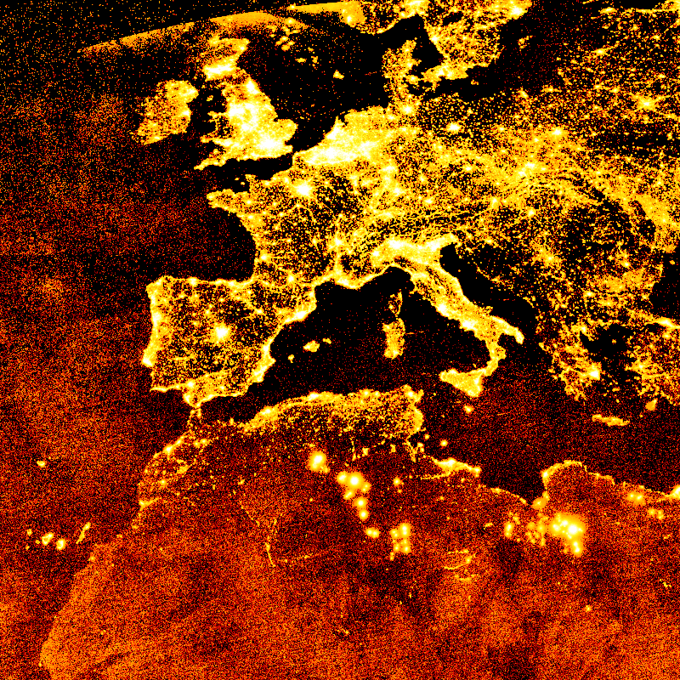
Experiment Section
Nighttime Light image of some parts of Europe and Africa

Slide 7
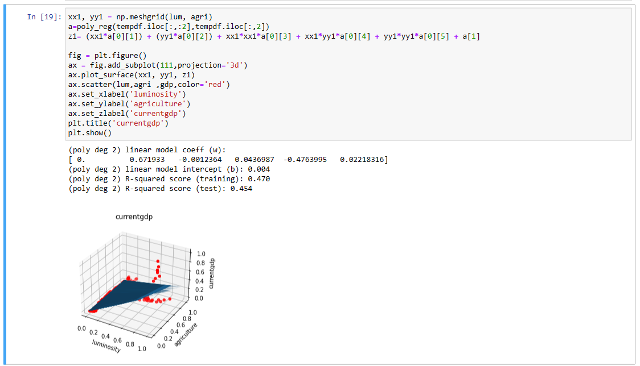
Experiment Section
The plot shows the relation of GDP against the variables luminosity and agricultural land cover.

Slide 8
Plans
At present, we have learned how to implement regression model for basic data set. We are planning to train on multiple data set to check its accuracy.
Further we are planning to look on the agriculture dataset to see correlation with economy (paper3)
Finally we will aim to use both nighttime light and agricultural land data to analyse economies of different countries.

